Slide 1
Authorship Attribution
Presented By:
Hazim Bukhari
Ahmed Aljmiai
Abdultawwab Safarji

Slide 2
Introduction
King Fahad library is looking for a way to help visitors find arabic authors based on the author’s writing style and recommend books with similar writing style.

Slide 3
Methodology
EDA
Preprocessing
Building Models
Model serving
Books per author, text length, etc… .
Remove tashkeel, sentence length, etc… .
transfer learning , built from scratch.
Serve the model on the web.

Slide 4
Data Descriptions
Authors
Books
Data Source
80 unique Authors
97 Book
Provided by SDAIA

Slide 5
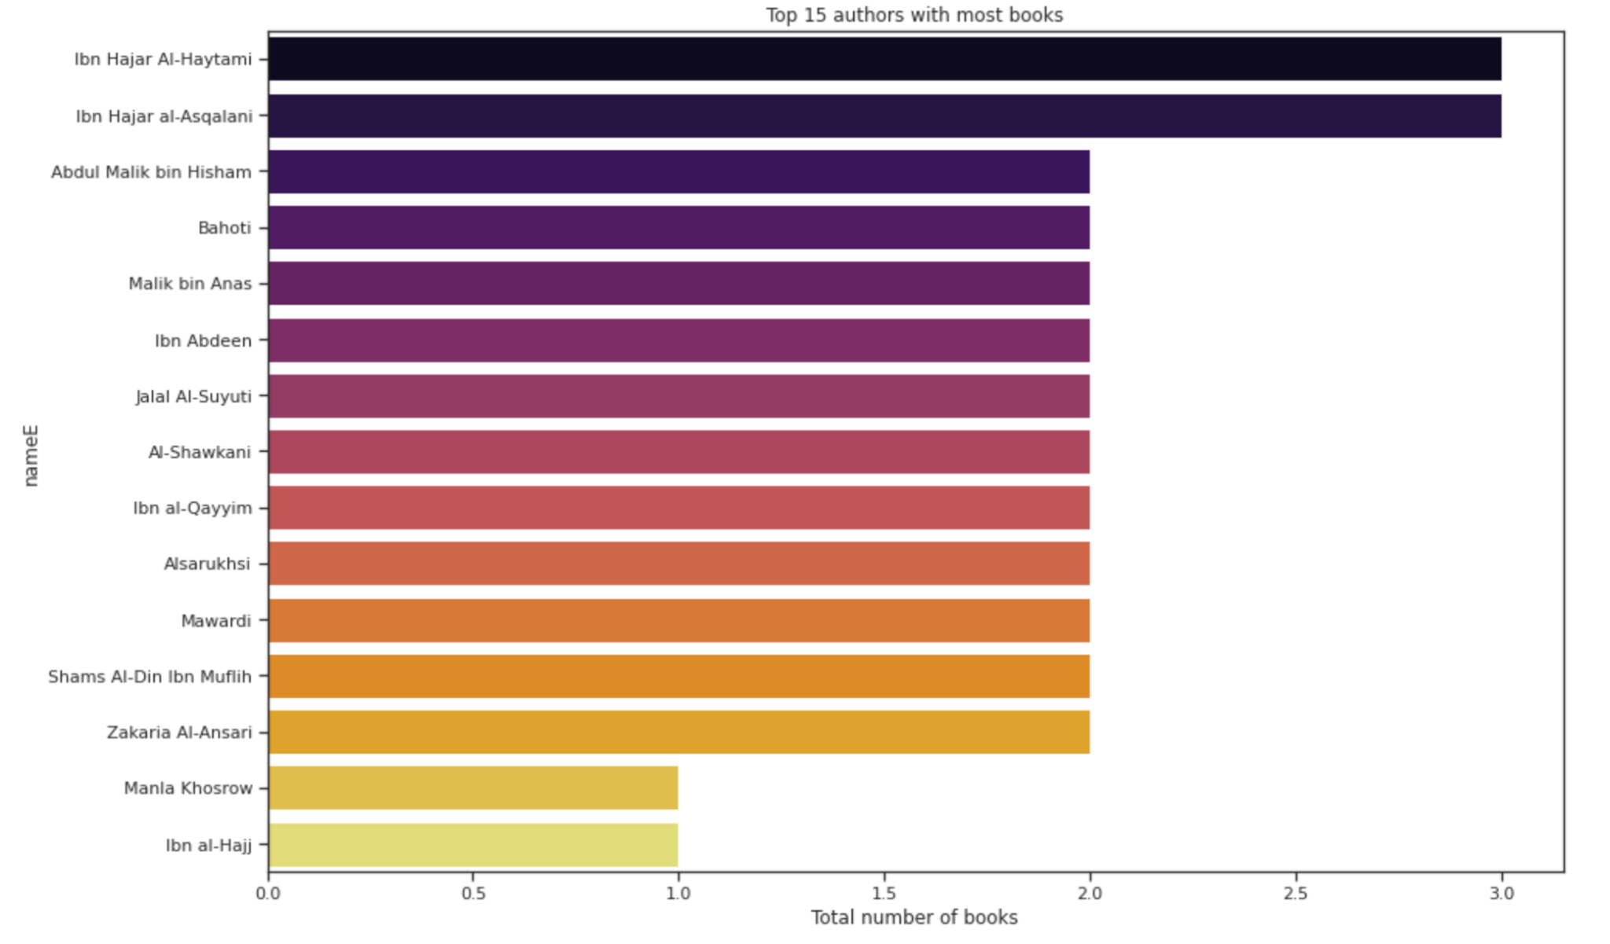
EDA:

Slide 6
Challenges
Unbalanced Classes
Training Time
Labeling
Corpus Size
Some authors have more books than others.
One epoch takes up to an hour to complete.
Finding the author of each book.
-exceeding 1gb.
-Min doc size ~30mb.

Slide 7
Distributed deep learning using TPUs:
Reducing computing time of ~42gb per 32 step per epoch.
Handling Big Data.
Using bert transformers
Google platforms: Google cloud platform and colab TPU back end.
Processing unit | CPU | GPU | TPU
Time | Train time>10 hrs | 4 hrs> Train time >3hrs | 8min >Train time> 13 min
Notes:
Assum
10kb for 1 char, 1 word is 5 char, each seq is 512 word, 128 seq per batch, 32 batch per step.

Slide 8
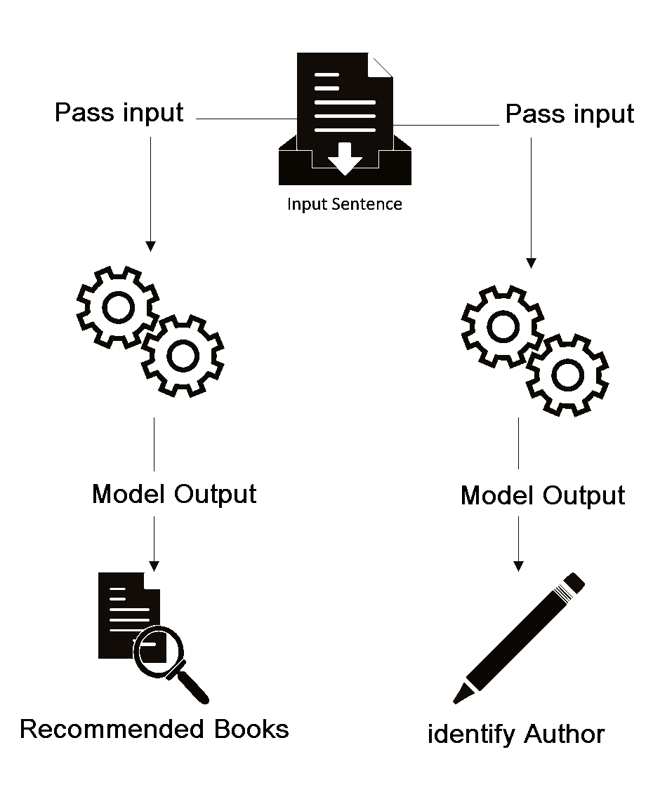
System Architecture:

Slide 9
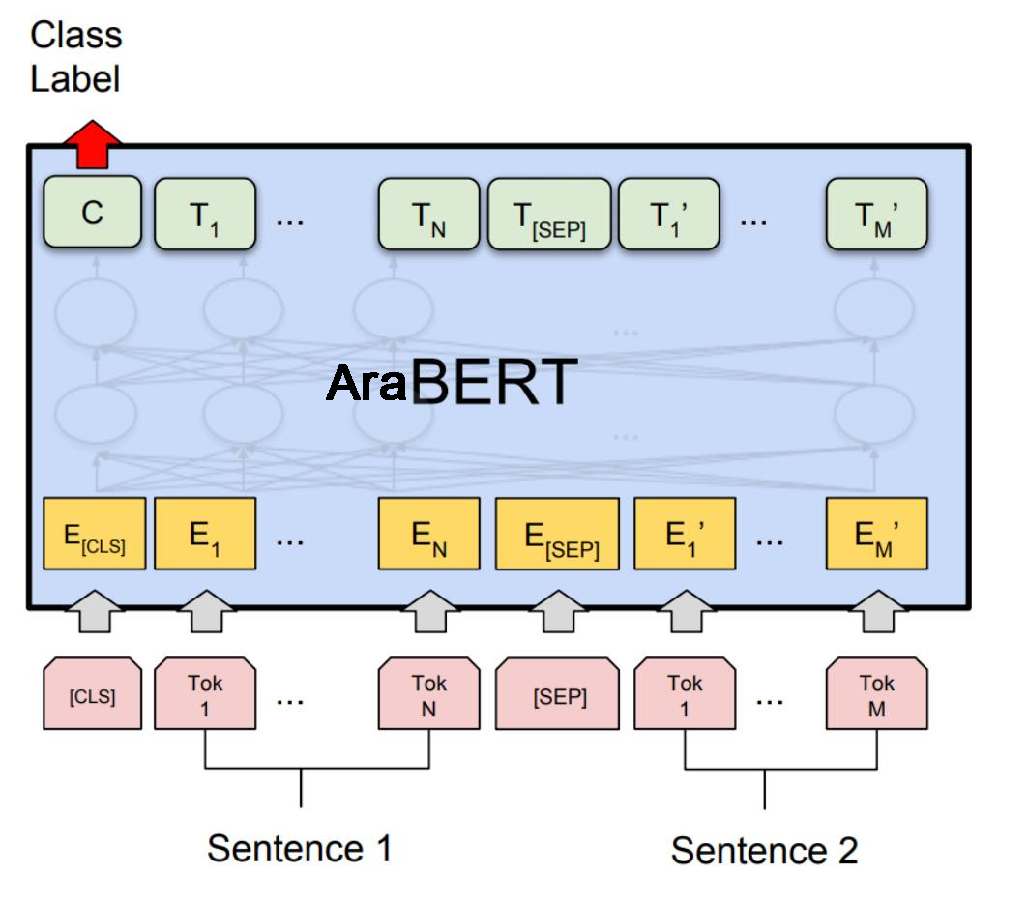
AraBERT Model:
Sequence Length 512.
Added layers: 1 Flatten, 2 Dense, 1 Output.

Slide 10
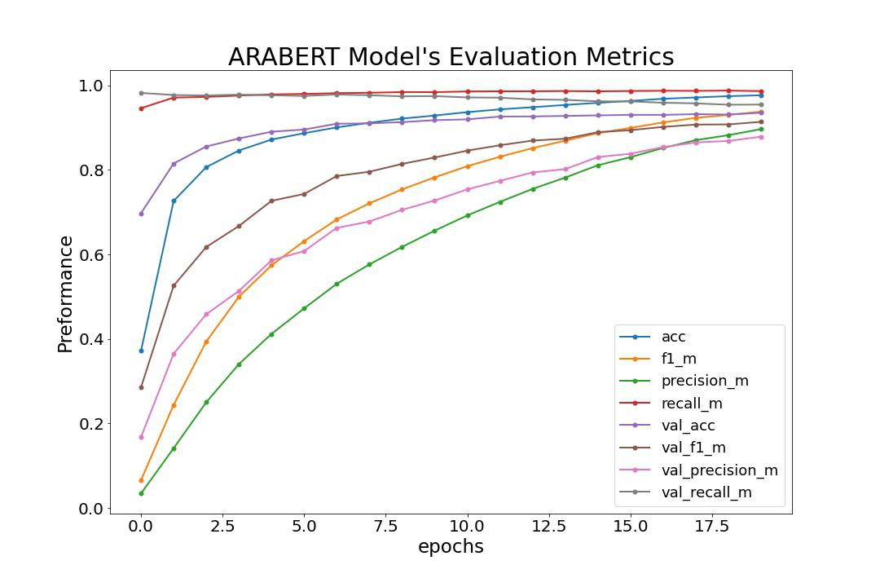
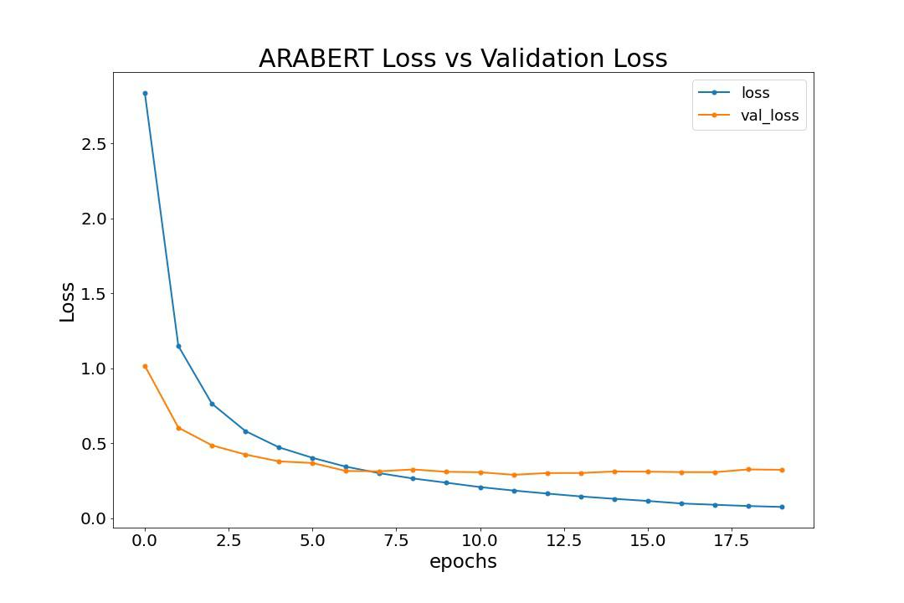
Classification Performance:

Slide 11
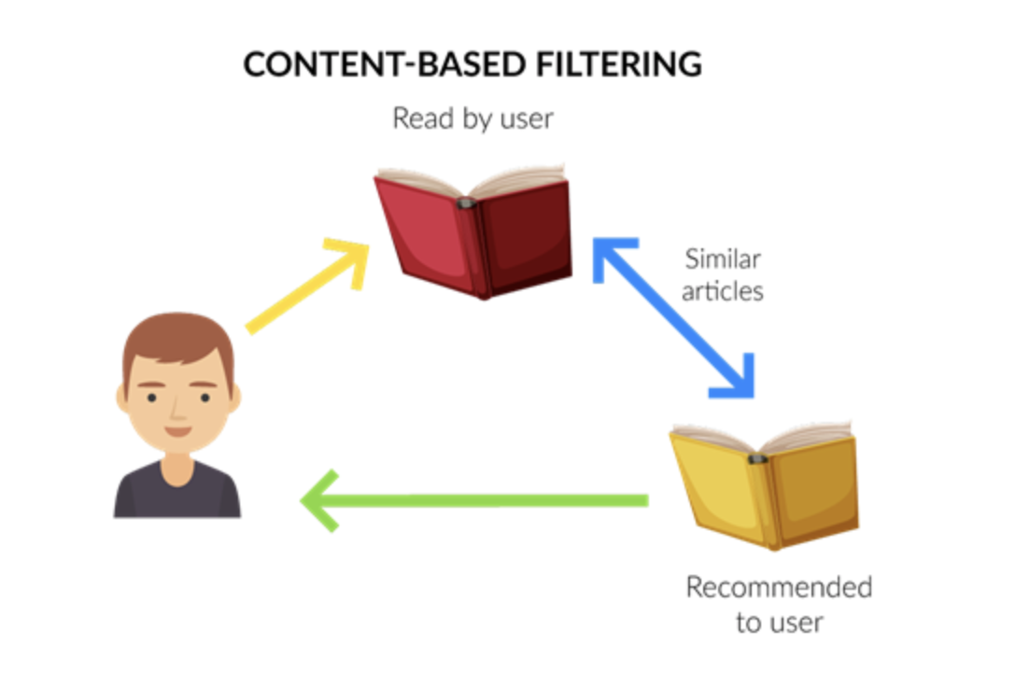
Recommender:
Recommend similar books based on a list of books read.
Act as an external service for the AraBERT model.
Recommend based on model output.

Slide 12
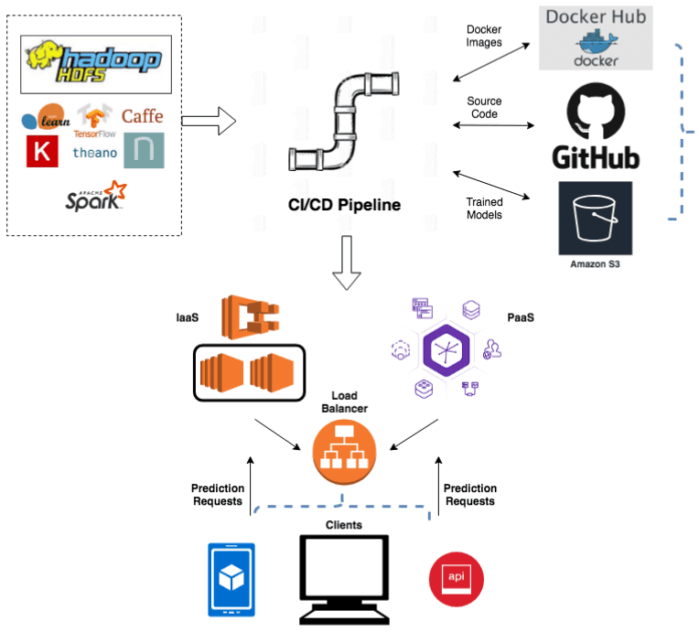
Challenges Deploying Deep Learning Models to Production:
Data & Experimentation:
Large data size (load & store)
Large trained transformer size
Production Deployment Workflow:
Prediction Time
Troubleshooting different services
Infrastructure Requirements
Code Quality

Slide 13


Demo:
Demo:

Slide 14
Future Work
01.
Summaries Books
02.
New Domains
03.
Enhance Recommender
04.
Text Generation
Show a summary of the recommend books.
Add authors from different domains.
Use Autoencoder to elevate the recommender system performance
Generate text similar in style to the input sentence.

Slide 15
Thanks For Listening!
QA

Slide 16

Appendix

Slide 17



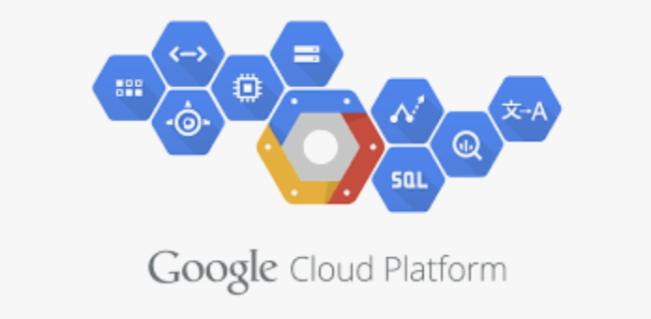

Tools

Slide 18
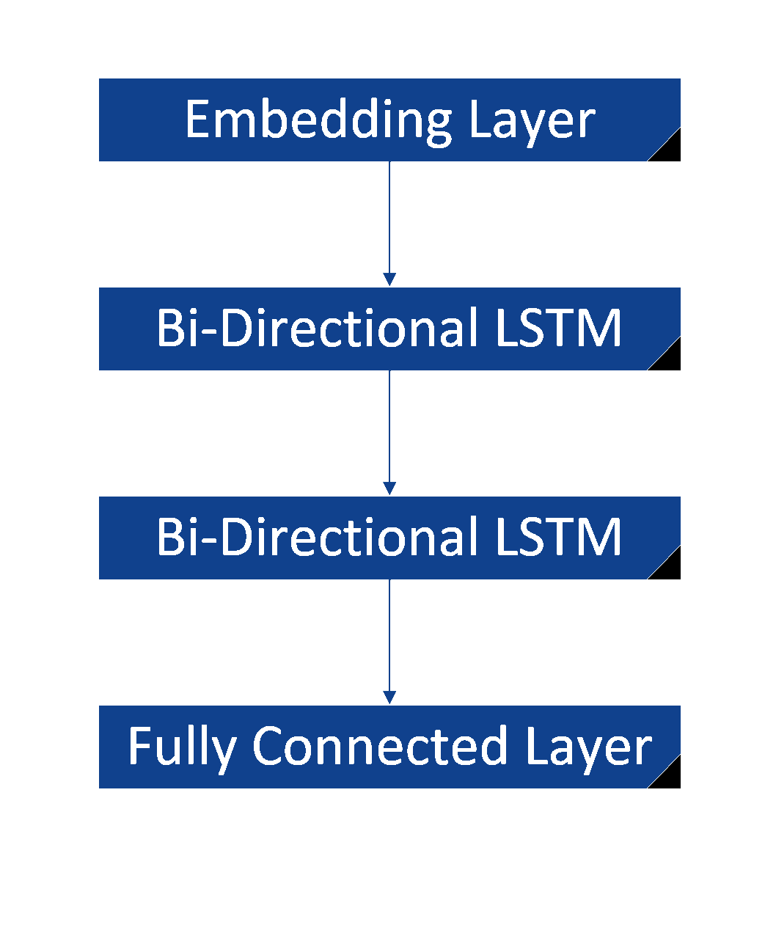
BI-LSTM Model:

Slide 19
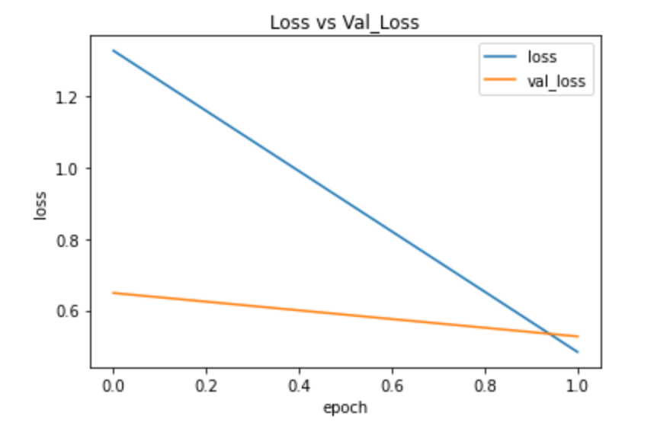
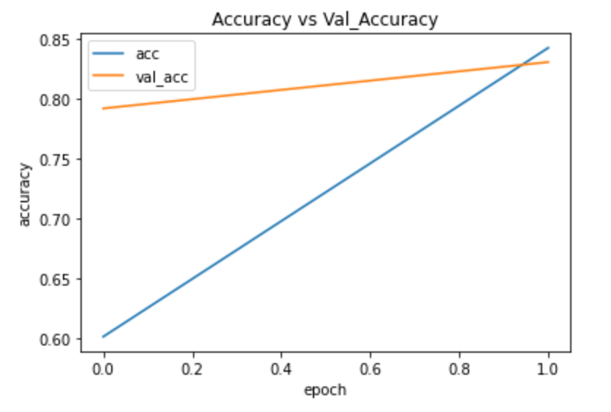
Classification Performance:

